Slide 1
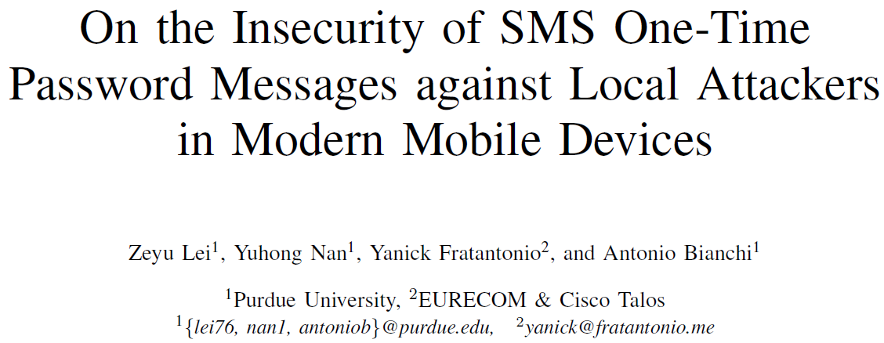

Slide 2
Introduction
SMS 1FA OTP（SMS One-Factor One-Time Password）
brings significant convenience to users
brings significant security implications
SIM-swapping attack
exploitation of the SS7 network
state-level attackers
Insecurely implement of SMS OTP
Local attacks
An attacker-domined malicious app installed on the victim’s device
Recent operating system has several changes to support SMS OTP authentication

Slide 3
Contribution
Systematize how the different mechanisms offered by the mobile operating system to implement SMS-based authentication can be attacked
Perform a user study and a large-scale automated study to show the impact of these attacks in practice
Propose improvements and modifications to the APIs currently available in mobile operating systems to implement SMS-based authentication

Slide 4
Threat Model
Attacker model and capabilities
Local attack: malicious installed in victim’s device
Internet permission
knows the phone number of the victim
Attacks not to be used in largescale, but targeted attacks
Assumptions on OS integrity
OS is not compromised
app isolation and permissions are properly enforced
secure Inter-process-communication (IPC) channel
consider out-of-scope UI-based attacks

Slide 5
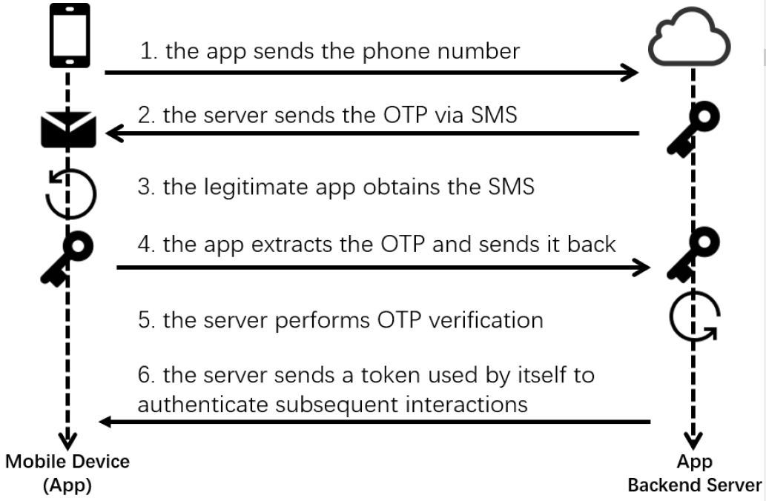
SMS 1FA OTP Schemes
Security Properties
OTP needs to have enough entropy
OTP needs to be verified
Retry attempts limitation
……
This paper:
Assume all security properties satisfied
Focus on step 3
Steal the OTP
Notes:
24/100 in top app

Slide 6
End-to-end Attack Scenario
The attacker initiates authentication with a victim app’s backend, specifying as phone number the victim’s one
The attacker uses the malicious app to steal the OTP that is received via SMS by the victim’s device, and sends the OTP out through the malicious app
When asked to insert the OTP in the authentication procedure initiated during the first step, the attacker uses the stolen OTP to complete the authentication procedure with the app’s backend, effectively pretending to be the victim

Slide 7
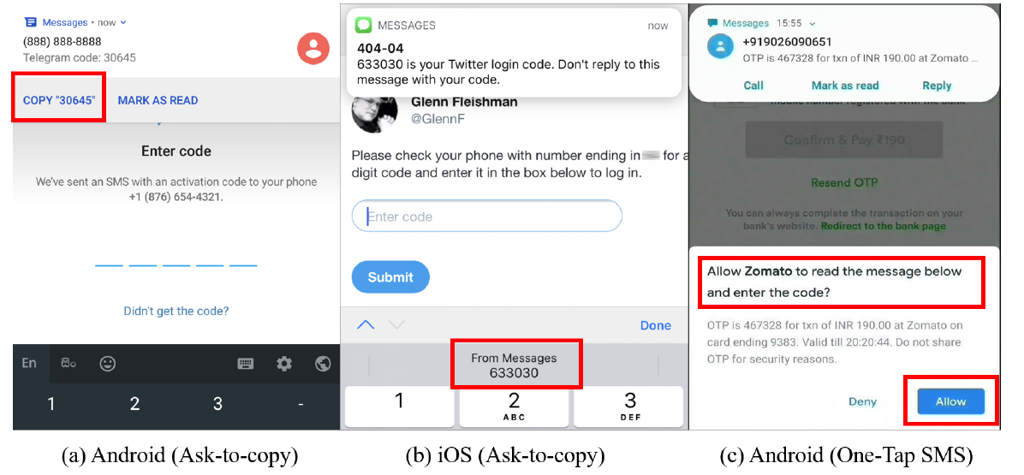
Methods to access SMS OTP Messages
Access with User Interactions
manually copy
ask-to-copy
One-Tap SMS verification

Slide 8
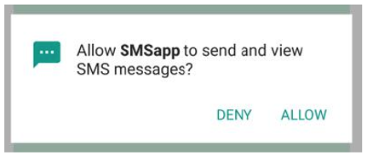
Methods to access SMS OTP Messages
Access by Requesting SMS
Relevant permissions
READ_SMS: read the SMS inbox at any time
RECEIVE_SMS: only read the “new” incoming messages
OS restriction
require a one-off user-consent at runtime(Fig. 3)
Market restricetions
SMS handler app: needs to allow the user to read received text messages, send new ones, etc
must ask the user if they want to change the current default SMS app to this one, upon its first usage
market performs manual, human-assisted verification of every app requiring these permissions
Fig. 3

Slide 9
Modern SMS APIs
App server to send the authentication SMS message with an additional identifiable string
Identifiable string allows the OS to only deliver the SMS message to the intended target app
Does not require the app asking for any Android permission

Slide 10
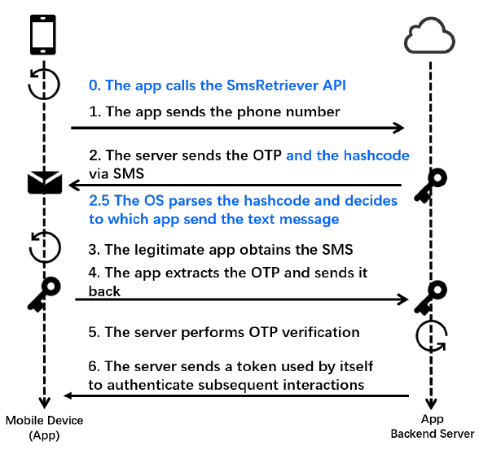
SMS Retriever
Uses a hashcode to specify to which app an SMS OTP should be delivered
only supported when the Google Play Service is available
Hashcode
signing certificate
packagename

Slide 11
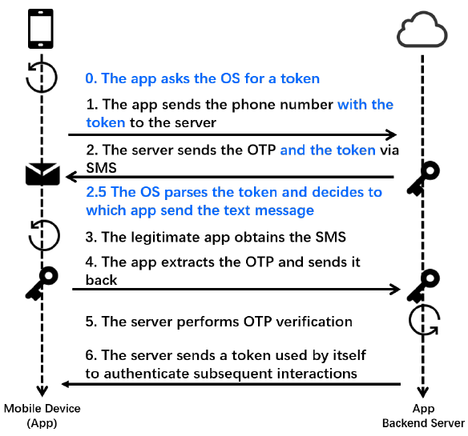
SMS Token(+)
SMS Token
Android version 8 or higher
inherently unsafe
Random token
SMS Token+
Android version 10 or higher
Only one difference according to the documentation
Provide an additional list of prefixes for SMS filtering

Slide 12
Deception attacks
Target: Access with User Interactions
Steps：
Malicious app asks the user for their phone number
Attacker remotely requests the SMS OTP message of legitimate app
victim receives an SMS OTP from legitimate app’s server
Victim inserts the received OTP into malicious app
without any SMS-related permissions
victim will receive one and only one message after the insertion of their phone number
victim user will likely input the OTP code in the phishing app

Slide 13
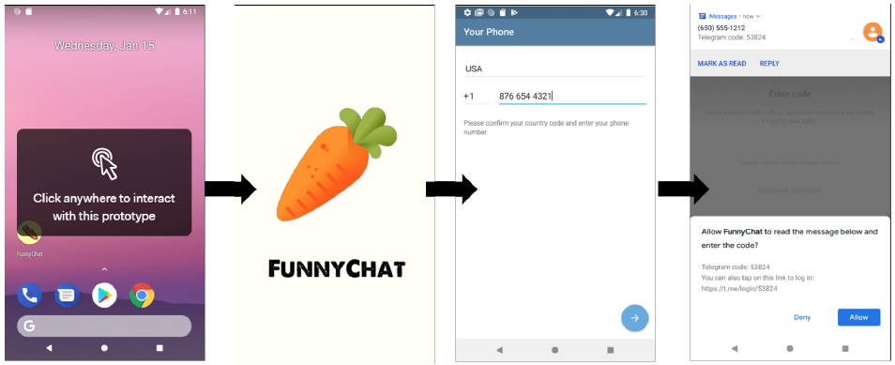
User Reactions to Deception Attacks
User Study
Manual -> One-Tap
45%~71% Compromised
Malicious app is able to change its name showing on the dialog
W1:
Users do not have a reliable way to identify the identity of the app in which they are asked to copy an SMS OTP message.

Slide 14
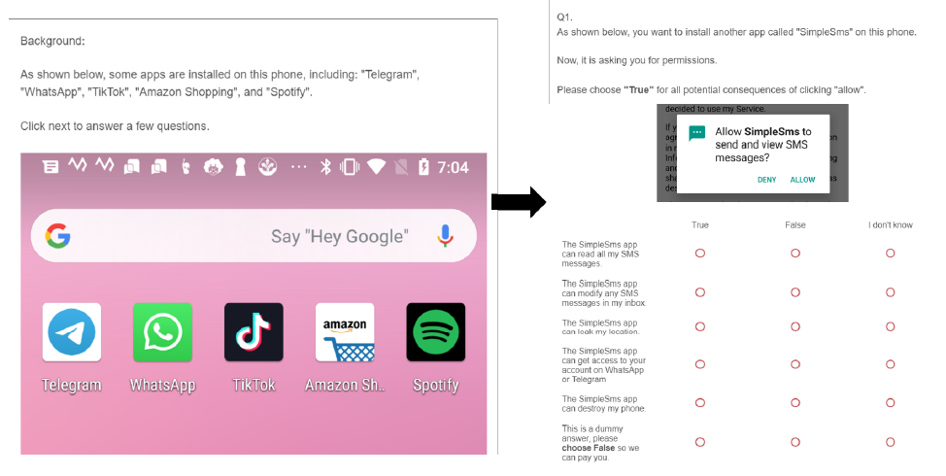
Bypassing SMS Permission Restrictions
Target: Access by Requesting SMS
Bypassing OS-level Restrictions
W2:
The system interface asking for the permission to read SMS do not explain the severe security implications that this choice can have.

Slide 15
Bypassing SMS Permission Restrictions
Bypassing Market-level Restrictions
App version update
human-assisted verification is not performed when the app is updated
W3: Market-level policies are not verified for updated versions of an already published app.
Requesting alternative permission
Read notification is a sidestep to read SMS
Hard to get the permission to read notification
Easier to publish to Google Play
W4: Market-level policies and OS-level policies are not aligned

Slide 16
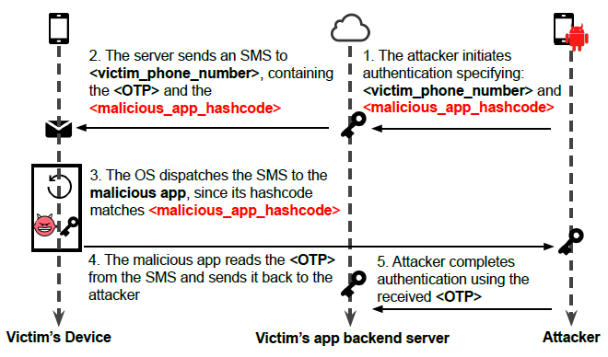
Exploiting modern SMS APIs
Attacking Apps using SMS Retriever
Vulnerable backend’s logic
Get Hashcode from client
Hardcode or Dynamically
W5:
The usage of the SMS Retriever API is error prone.

Slide 17
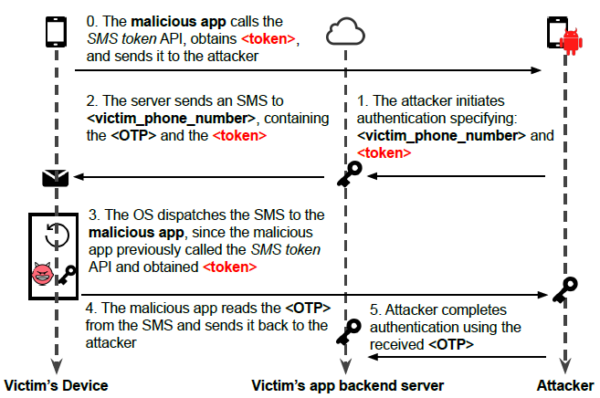
Exploiting modern SMS APIs
Attacking Apps using SMS Token
This API is inherently unsafe
App’s backend cannot tell user or attacker by random token
W6:
The usage of the SMS Token API for authentication purposes is unsafe due to its vulnerable design

Slide 18
Exploiting modern SMS APIs
Attacking Apps using SMS Token+
Vulnerable due to the incorrect documentation
The returned token is always equal to the calling app’s hashcode
Safely usage is to always place the client’s hashcode prepared before by server in SMS OTP messages
W7:
The SMS Token+ API documentation suggests using it in the same way of the SMS Token API, thus making its usage equally insecure.

Slide 19
Additional Design Weakness
Modern APIs’ Inbox Management
SMS Retriever API
always stores the received SMS messages
SMS Token(+)
previously called these APIs and get token T
The incoming SMS message contains T
Bypass: lure server to return useless token T
W8: SMS OTP Messages are stored in the SMS inbox, even when obtained with APIs designed to deliver them only to a specific app

Slide 20
Additional Design Weakness
Cryptographic Weaknesses
Hashcode is computed by converting a SHA256 hash to a base64 string and truncating it to 11 characters
Reduces the strength of the hashing algorithm to 66 bits
NIST guidelines mandate not to truncate a SHA256 hash to less than 224 bits
Market operators do not verify the absence of hashcode collisions among published apps.
W9:
The SMS Retriever API does not respect security guidelines in terms of hashing strength. The market does not check for hashcode collisions.

Slide 21
Large-scale Measurement
Dataset
Filter:
Downloads > 50000
2019.12~2020.02
Google Play & AndroidZoo
Total count: 140586 apps
Vulnerable App Identification
Static analysis
To discover potentially vulnerable apps
Steps
Detect hardcoded hashcode
String matching
Detect dynamically calculated hashcode
check if the app invokes specific APIs
Using data flow analysis to detect if the hashcode is indeed sent out through a network API

Slide 22
Large-scale Measurement
Dynamic confirmation
Steps
Reverse engineer to confirm the usage of the detected APIs as part of their authentication scheme → Suspicious
Instrument the app to modify the hashcode or Token and triggering its authentication procedure → Confirmed
the backend server code logic got updated after we notified the developers of the vulnerability → Fixed
FP of Static Analysis
caused by those apps using hashcode for app integrity check

Slide 23
Large-scale Measurement
Result
20 confirmed with more than 133 million installations
36 vulnerable apps, sharing more than 230 million installations
Some Suspicious can be Confirmed(need international phone number)
SMS token+ has no candidate because it’s a new API of Android 10

Slide 24
Case Study
KakaoTalk
Using SMS Retriever
used by 93% of the smartphone owners in South Korea
Attack steps
Malicious app in victim’s device invoke SMS Retriever
On attacker’s device, sign up KakaoTalk using victims phone number
Change the hashcode to be sent to server with malicious hashcode
Server send SMS OPT with malicious hashcode to victim’s device
On the victim’s device, OS deliver SMS OTP to the malicious app
Malicious app send the SMS OTP to attacker’s server by Internet

Slide 25
Case Study
Telegram
has more than 100 million downloads in the Google Play
Using SMS Token API
Sinch Library
an Android authentication library, targeting Android apps’ developers
uses the vulnerable SMS Token mechanism
uses the SMS Retriever mechanism in a vulnerable way
explicitly instructs developers to insert their hardcoded hashcode
Telegram, KakaoTalk fixed; Sinch Library not yet

Slide 26
Mitigation Strategies
Ideal properties
The OTP-carrying SMS should be automatically forwarded to the appropriate app (no manual insertion)(W1)
The SMS should only be delivered to the proper app using an SMS Retriever-like method(W6,7)
It should have appropriate documentation (W5) and use proper crypto (W9);
An OTP-carrying SMS should never reach the SMS inbox (W2~4, W8)
The user should be able to see the received messages
It should be easily usable by existing apps on existing mobile devices.

Slide 27
Mitigation Strategies
Our proposal similarly as SMS Retriever with modifications(W6)
SMS OTP messages using this API must start with a precise prefix (e.g., “<OTP >”)
Messages starting with the specific prefix, under no circumstances, are delivered to the SMS inbox(W8)
Messages starting with the specific prefix can be visualized by the user using a dedicated system app.
Messages are delivered to the app whose hashcode is contained in the message itself.(W1)
The hashcode is computed as in the current SMS Retriever API, but its length is truncated to 38 base64 characters instead of 11(W9)

